Slide 1
Concurrent and Parallel Systems Time analysis
Dr Sergio Davies <sergio.davies@shu.ac.uk>
Department of computing
Sheffield Hallam University
7 October 2022

Slide 2
Topics
Last week: Race conditions and mutex variables
Today:
Speedup
Amdhal’s law
Estimate of time required to create and delete a thread

Slide 3

Definitions
Speedup
A number that measures the relative performance of two systems processing the same problem. More technically, it measures the improvement in speed of execution of a task executed on two similar architectures with different resources; [Wikipedia – Speedup]
Symbol used to indicate a thread of execution:

Slide 4
Execution time
Single-thread matrix multiplication:
Multi-thread matrix multiplication
t1
Matrix data loading
t1
Matrix data loading
t2
Product computation
t4
Product computation
t3
Result file writing
t3
Result file writing

Slide 5
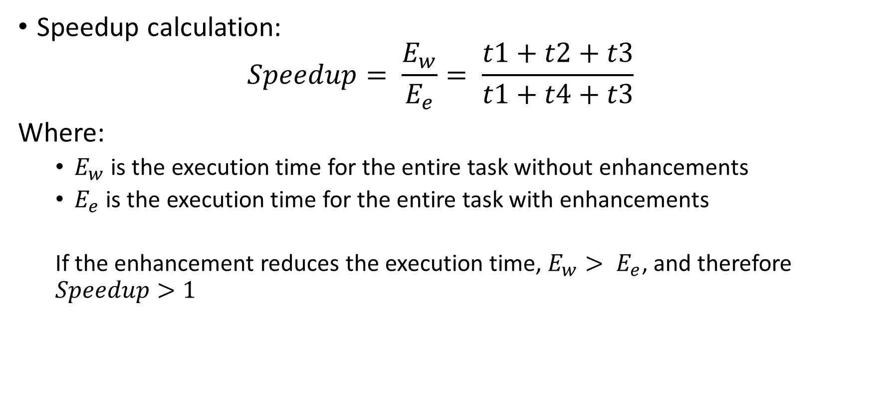
Speedup
Speedup calculation:
$$Speedup= \frac{E_{w}}{E_{e}}= \frac{t1+t2+t3}{t1+t4+t3}$$ Where:
$E_{w}$ is the execution time for the entire task without enhancements
$E_{e}$ is the execution time for the entire task with enhancements
If the enhancement reduces the execution time, $E_{w}> E_{e}$, and therefore $Speedup>1$

Slide 6
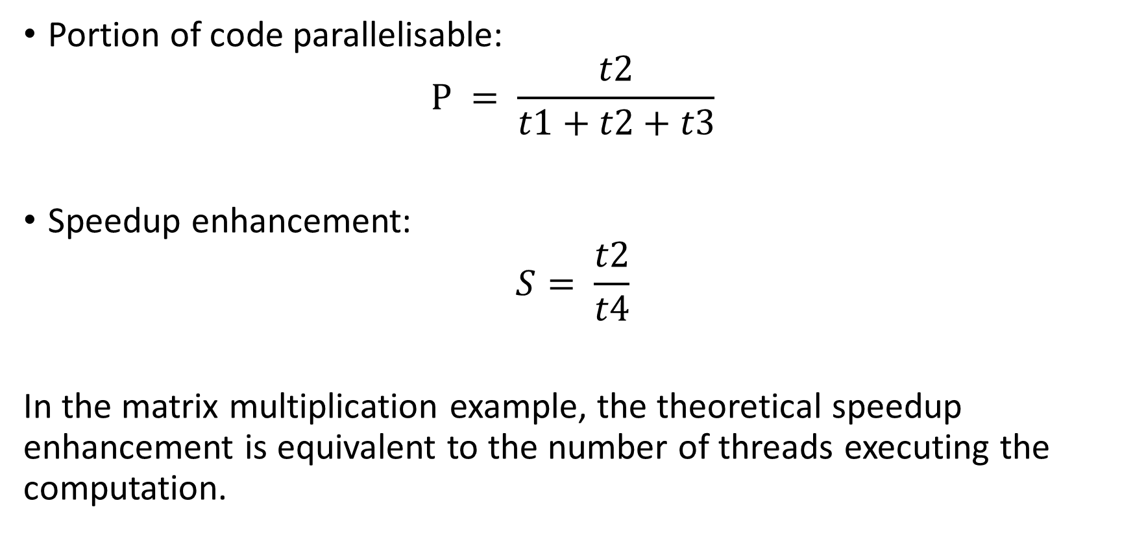
Speedup
Portion of code parallelisable: $P = \frac{t2}{t1+t2+t3}$
Speedup enhancement:
$$S= \frac{t2}{t4}$$
In the matrix multiplication example, the theoretical speedup enhancement is equivalent to the number of threads executing the computation.

Slide 7
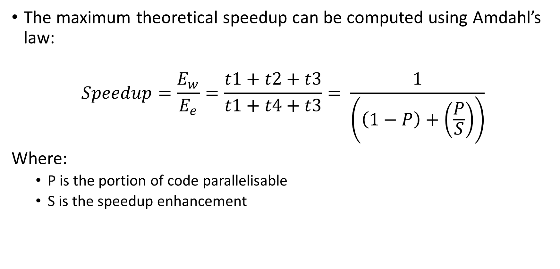
Amdahl’s law
The maximum theoretical speedup can be computed using Amdahl’s law:
$$Speedup=\frac{E_{w}}{E_{e}}=\frac{t1+t2+t3}{t1+t4+t3}= \frac{1}{\left(\left(1−P\right)+\left(\frac{P}{S}\right)\right)}$$
Where:
P is the portion of code parallelisable
S is the speedup enhancement

Slide 8
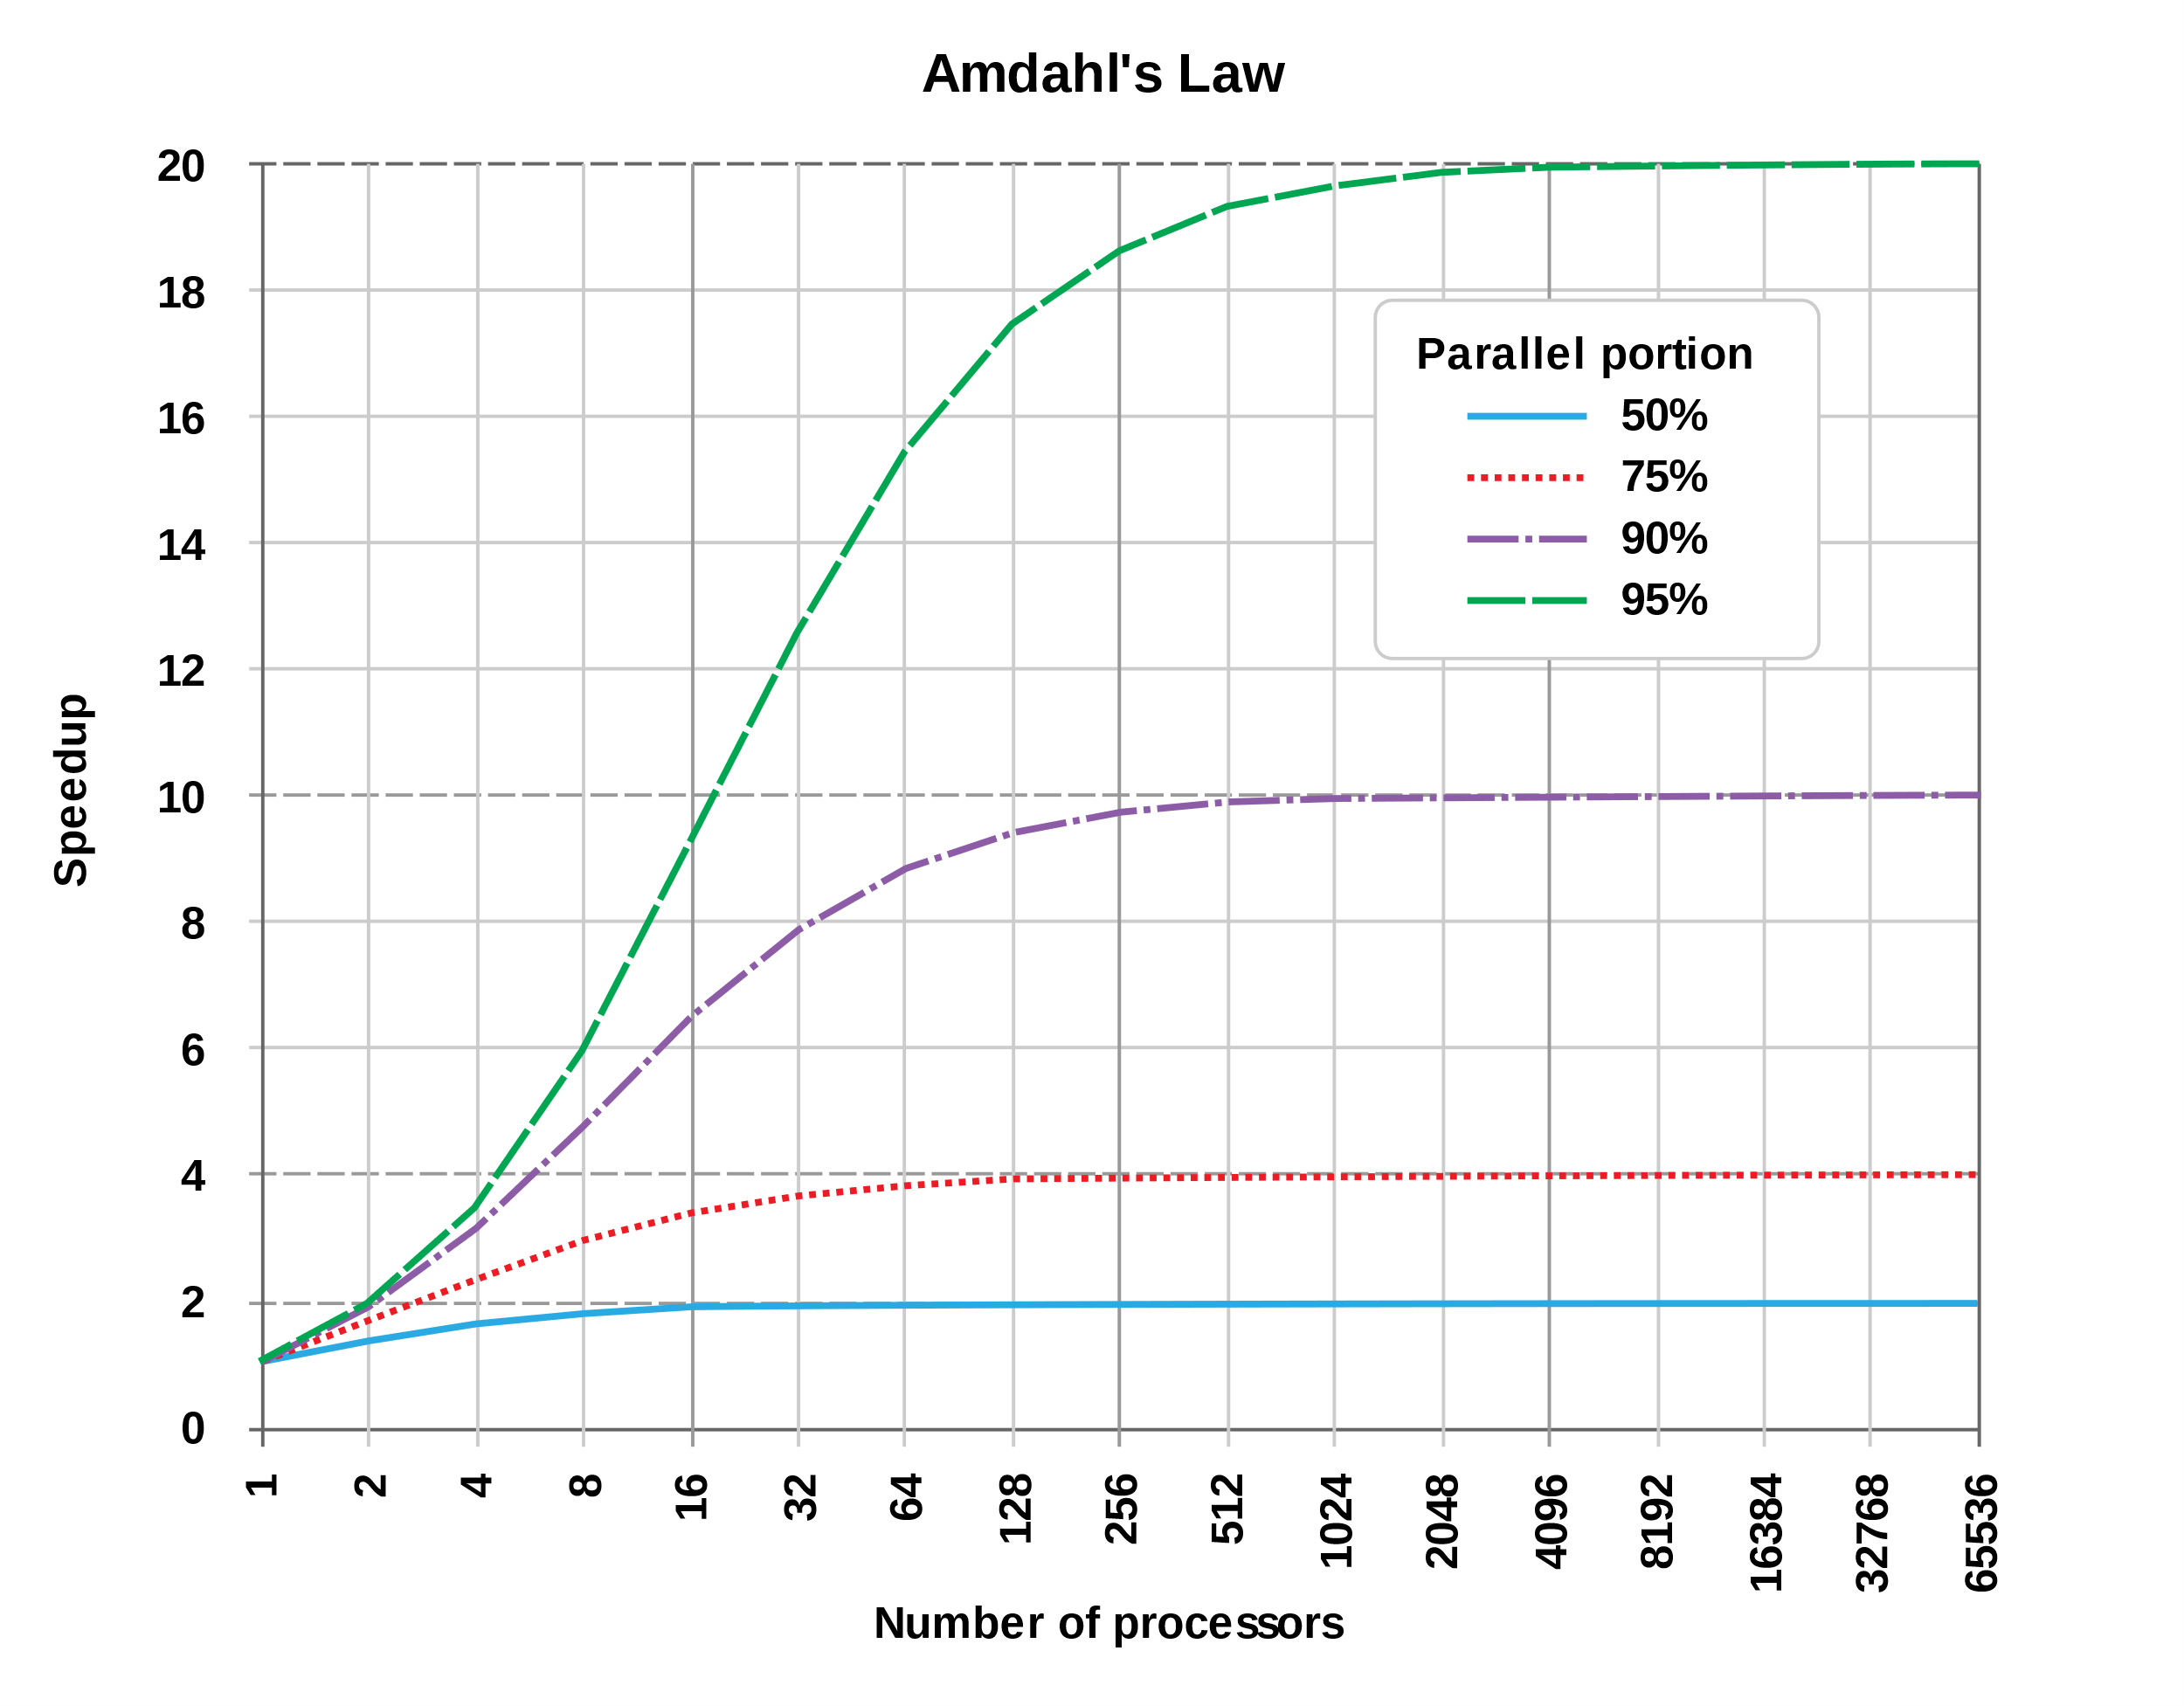
Amdahl’s law
[Wikipedia – Amdahl’s law]

Slide 9
Measuring time with accuracy
LARGE_INTEGER StartingTime, EndingTime, ElapsedMicroseconds, Frequency;
QueryPerformanceFrequency(&Frequency); QueryPerformanceCounter(&StartingTime);
// Activity to be timed
QueryPerformanceCounter(&EndingTime);
ElapsedMicroseconds.QuadPart = EndingTime.QuadPart - StartingTime.QuadPart;
// We now have the elapsed number of ticks, along with the number of ticks-per-second. We use these values to convert to the number of elapsed microseconds. To guard against loss-of-precision, we convert to microseconds *before* dividing by ticks-per-second.
ElapsedMicroseconds.QuadPart *= 1000000;
ElapsedMicroseconds.QuadPart /= Frequency.QuadPart;

Slide 10
Measuring time
void StartCounter() {
if(!QueryPerformanceFrequency(&li))
std::cout << "QueryPerformanceFrequency failed!\n";
PCFreq = double(li.QuadPart)/1000.0;
QueryPerformanceCounter(&liStart); }
double GetCounter() {
QueryPerformanceCounter(&liEnd);
return double(liEnd.QuadPart - liStart.QuadPart)/PCFreq;}
int main() {
StartCounter();
Sleep(1000);
std::cout << GetCounter() <<"\n";
return 0; }

Slide 11
Run example – ex2

Slide 12
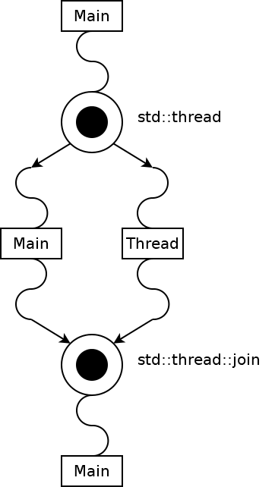
Measuring thread start-up time
How to measure the time to create a thread?
Measure time before std::thread variable creation
Measure time after variable creation is completed
Which of the two sides of the execution?
The shorter of the two sides is the desired measure

Slide 13
Run example – ex5
Average time to create a thread?
Why multiple iterations for measurement?

Slide 14
Measuring thread termination time
How to measure the time to join a thread?
Measure time before std::thread::join call
Which of the two sides of the execution?
Measure time after variable creation is completed
The shorter of the two sides is the required measure

Slide 15
Run example – ex6
Average time to shut down a thread?

Slide 16
TUTORIAL: Time analysis on matrix multiplication software

Slide 17
Tutorial session
Compute the theoretical speedup, using Amdahl’s law, of the three versions of your software for multiple matrix sizes;
Compute the speedup given by the multithreaded implementations of your matrix multiplication code, compared with the single-thread version varying the size of the source matrices. The matrices could be generated using a random number generator with varying matrix sizes;
Use a fixed number of threads equal to the number of CPUs on your computer;

Slide 18
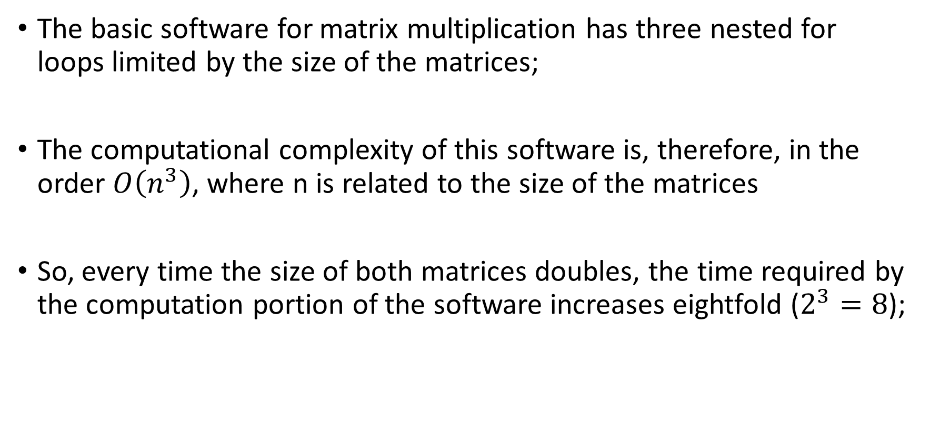
Theoretical time variations
The basic software for matrix multiplication has three nested for loops limited by the size of the matrices;
The computational complexity of this software is, therefore, in the order $O\left(n^{3}\right)$, where n is related to the size of the matrices
So, every time the size of both matrices doubles, the time required by the computation portion of the software increases eightfold ($2^{3}=8$);

